Slide 1
UNV Thermographic Fever Screening Solution

Slide 2


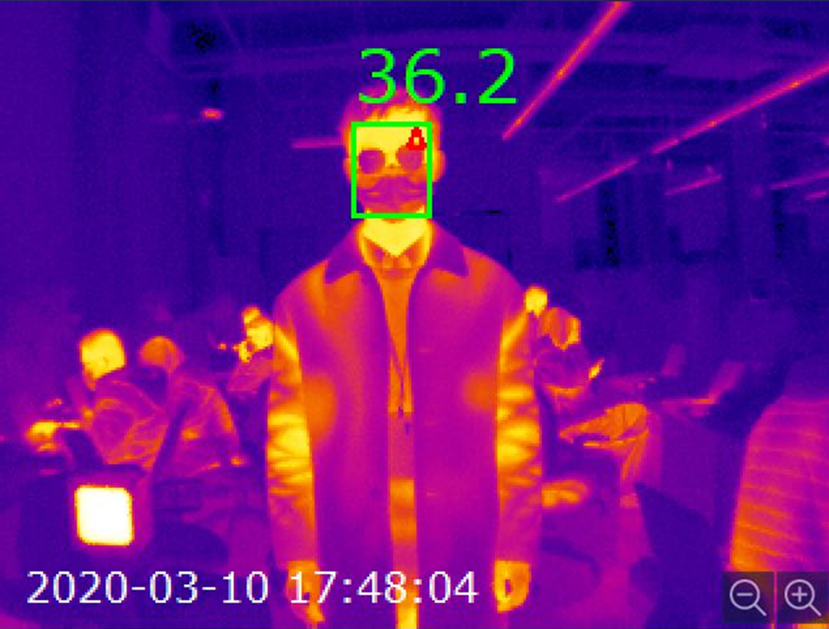
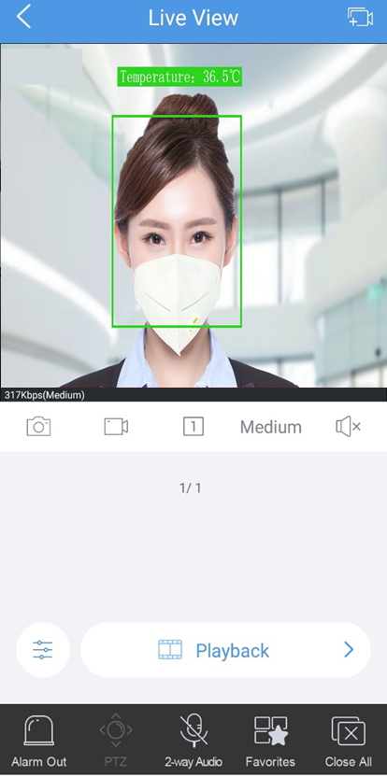
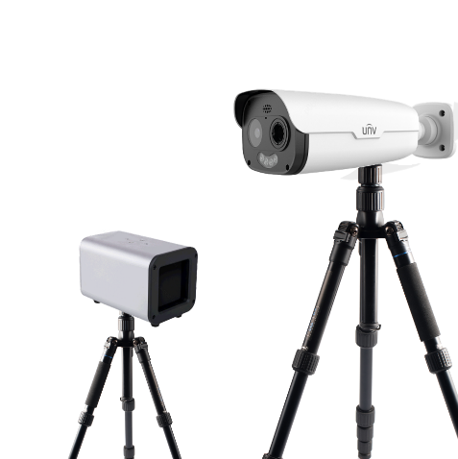
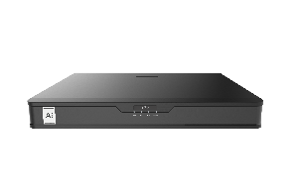
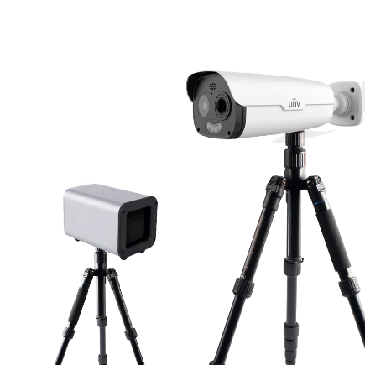
Solution Overview
Topology
Overview
Local GUI
App
Solution Composition
1*Bullet thermal camera, 1*Black body , 2*Tripod, 1*AI NVR
Blackbody
Set up tips
Keep the distance between target and camera about 4 ~6m
The black body is used to calibrate the temperature detection, recommended to put 5m away from the camera
Make sure that the black body would not be blocked by other targets during temperature detection
Recommend to set up the solution in a stable environment without wind in the indoor space .
5m
AI NVR
NVR-302-16E-IF
Thermal camera
4~6m
TIC2531TER5-F10-4F6APCA
High Accuracy
Only ±0.3℃（with blackbody）for quick non-contact preliminary screening
Smart Solution
Measure temperature based on face detection, filter false alarm caused by other objects
Notes:
When the thermal camera is connected to the NVR, it can display both visual and thermal live view, face recognition result, corresponding temperature detected, abnormal (elevated) temperature alarm, temperate search and report export.

Slide 3
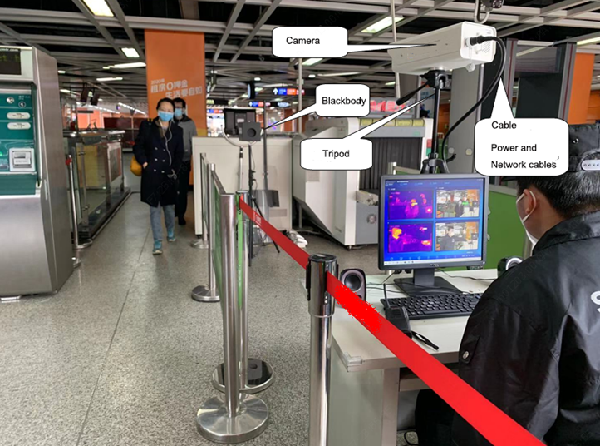
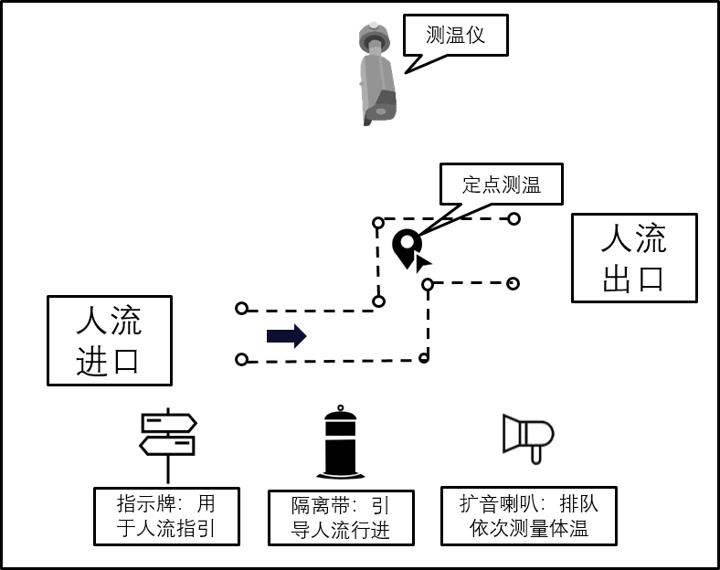
Fever Screening Process
Quick Inspection Channel
Thermal Camera
Inspection
Point
Inspection
Exit
Set up a quick channel
Set up a quick screening channel in the indoor space to separate space into few parts.
Thermal camera quick screening
Using thermal fever screening solutions to do quick screening of moving crowd and ensure the efficiency
Thermometer secondary check
For the person who is doubt fever symptoms, using thermometer to do secondary check is necessary.
1
Inspection
Entrance
2
3
Sign
Isolation
belt
Loudspeaker

Slide 4
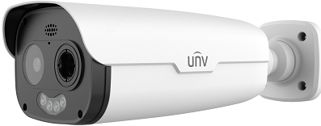
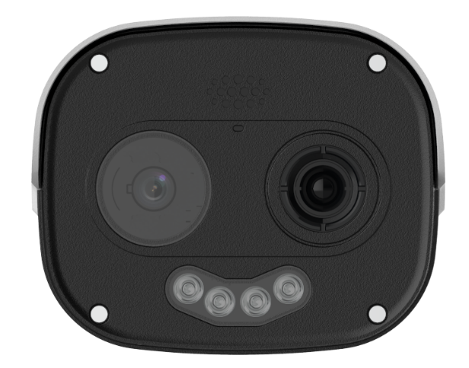


Camera Features
Structure
Micro SD, up to 256 GB
Alarm 2 in and 2 out, Audio 1 in and 1 out
IP66 ingress protection
Thermal Camera
Vanadium Oxide Uncooled Focal Plane Arrays
384*288 resolution, max 25fps
9.6mm fixed lens
Built in speaker
Built in IR lights, red and blue warning lights
Optical Camera
1/1.8", 4MP, max 60fps
120dB WDR
6mm@F1.6 fixed lens
Min Color : 0.001lux
Built in MIC
Dual-spectrum imaging
Audio and light alarm
Attributes Detection
One IP address for Optical & Thermal channel
Support alarm when no mask and abnormal temperature are detected
Attributes detection includes face ID, mask & human body temperature status

Slide 5
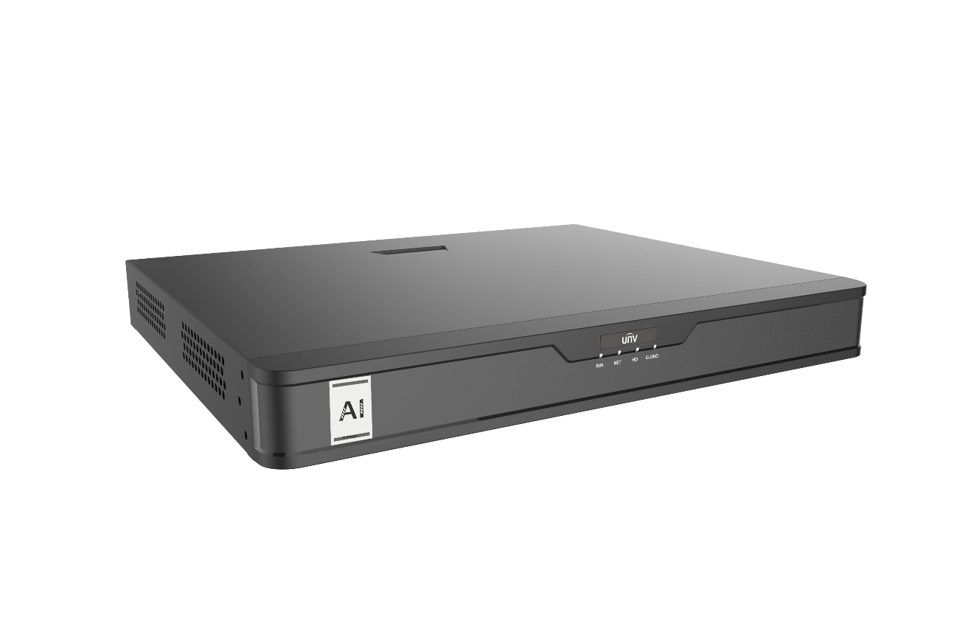
NVR Features
Export face recognition results, temperatures and snapshots
Temperature unit switching
Abnormal events (elevated temperatures, not wearing masks) search and recording
Quick Fever screening
Face ID & attributes recognition
Mask detection and recognition

Slide 6
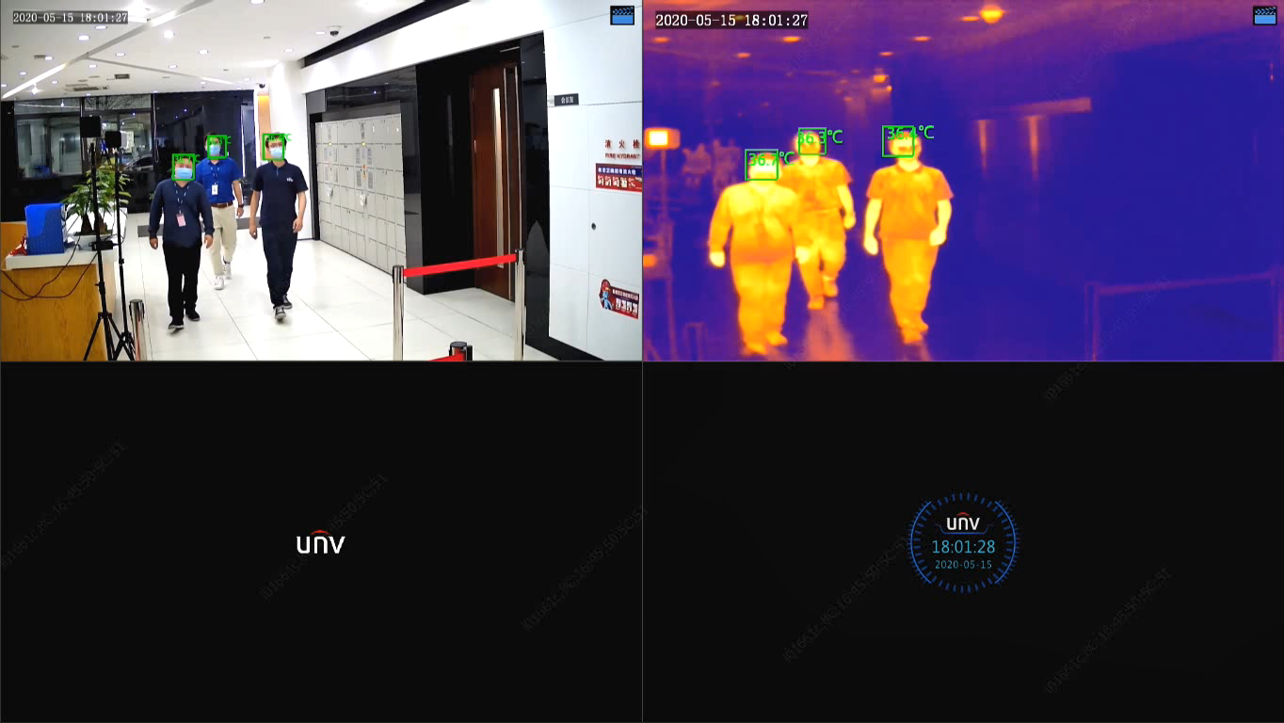

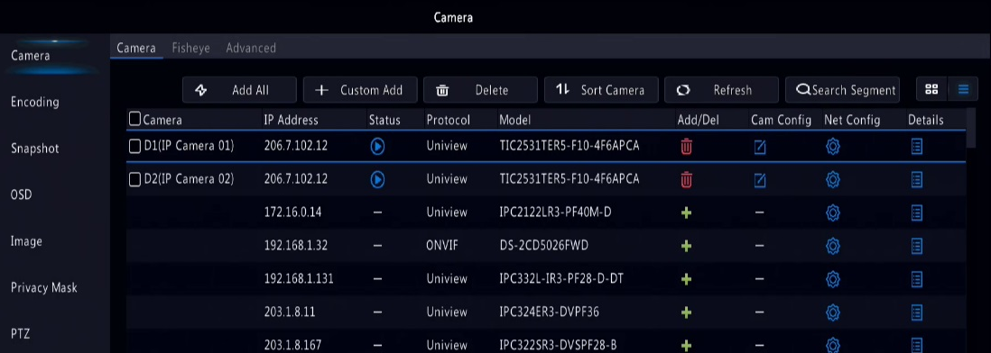
Quick Fever screening
Camera
AI NVR
Camera
1 thermal camera occupies 2 channels(visual and thermal)
When using One-click add, it will add 2 channels by default
Max. 2 thermal cameras recommended (1-4 channels).

Slide 7
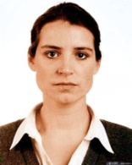

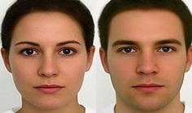

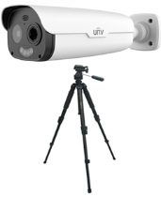
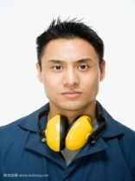
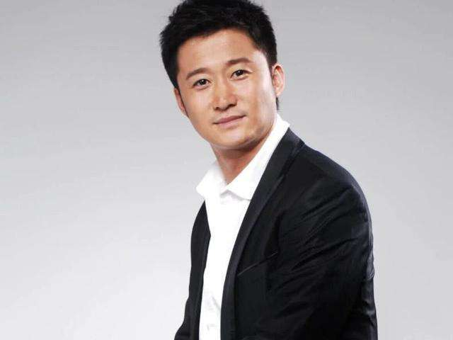
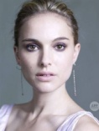
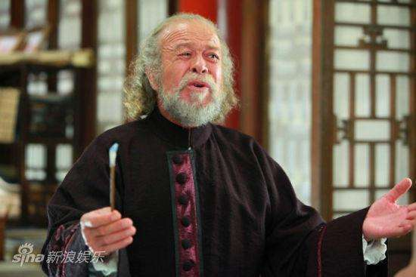


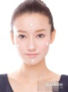

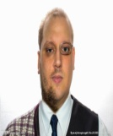
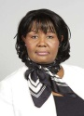
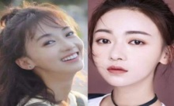
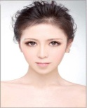
Face ID & Attributes Recognition
Import face library by snapshot captured by NVR
Camera
snapshot
Compare
Import face library by computer
temperature
Face library
Snapshot
Import face library
Face recognition result ,attributes and intelligent marks (temperature &box ) display on screen
This system not only detects body temperature, but also associates temperature to specific person by face recognition.
It supports export report for further management. It’s suitable for schools, companies and other scenarios.

Slide 8
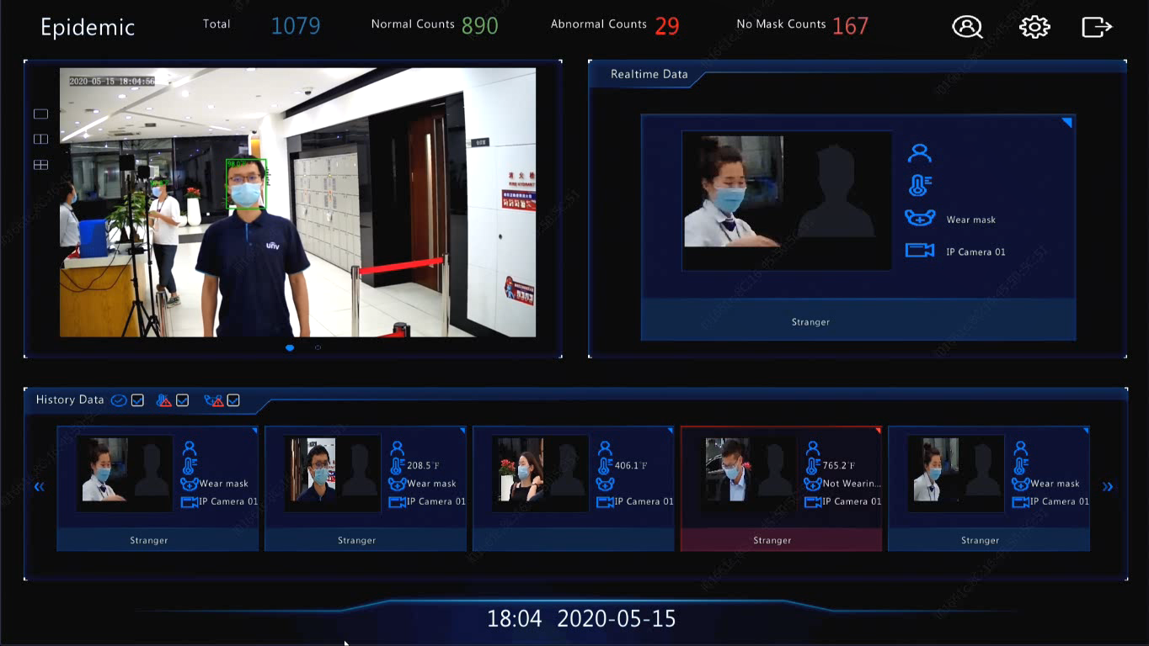
Display
Preliminary screening interface
Intuitive Dashboard
Total counts, normal or abnormal temperature counts, not wearing mask counts
Realtime Data
Name
Temperature
Wearing mask or not
Multi - layouts
1 window
2 windows
4 windows
Historical Data

Slide 9
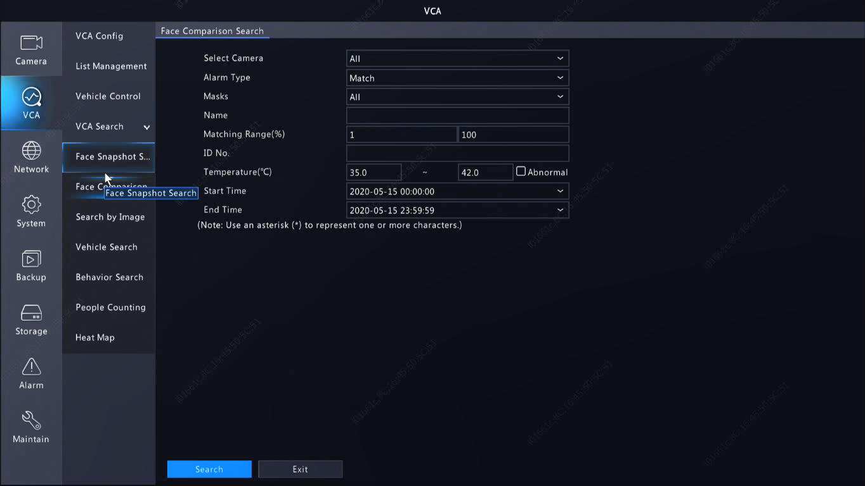
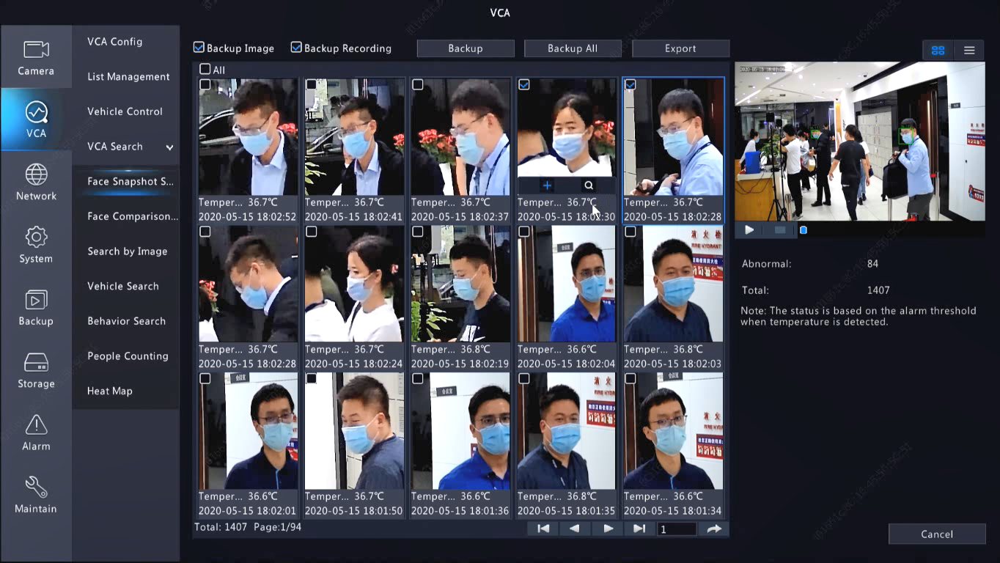
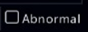
Abnormal Events Search & Recording
【Abnormal events search】
【Face snapshot and recording】
No wearing mask search
Abnormal (elevated) temperature , When checked,
the search range will change to designed thresholds automatically
Snapshot, face recognition result and temperature results
5S recording ,no temperature
Report export(excel CSV format, details refer to following pages)
Snapshot(small face snapshot, original snapshot) and recording backup

Slide 10
Export Report
Export report Temperature ,snapshot and recognition picture export
Table
Number of temperature anomalies | 1
Normal temperature number | 1
Number of temperature detection | 2
Camera | Camera Name | Alarm Time | Temperature | Name | Result | Capture Path | Library Path
D1 | Temp Detection Camera 01 | 2020/4/11 10:16:37 | 37.8 | July | Abnormal | ./SnapImage\D1_Temp Detection Camera 01_20200422152828.jpg | ./CompareImage\D1_Temp Detection Camera 01_20200422152828.jpg
D1 | Temp Detection Camera 01 | 2020/4/11 17:35:52 | 36.6 | Lucy | Normal | ./SnapImage\D1_Temp Detection Camera 01_20200422152836.jpg | ./CompareImage\D1_Temp Detection Camera 01_20200422152836.jpg
When exporting the report, it will also export two image files, one is snapshots captured, one is face library. When click the hyperlinks in the report, it will link to corresponding pictures
Format: excel CSV
One-to-one corresponding display between temperature and people (pictures)
Notes:
导出来的图片是人脸小图，有可能没有温度数据
用备份出来可以将大图导出来，会有温度数据。

Slide 11
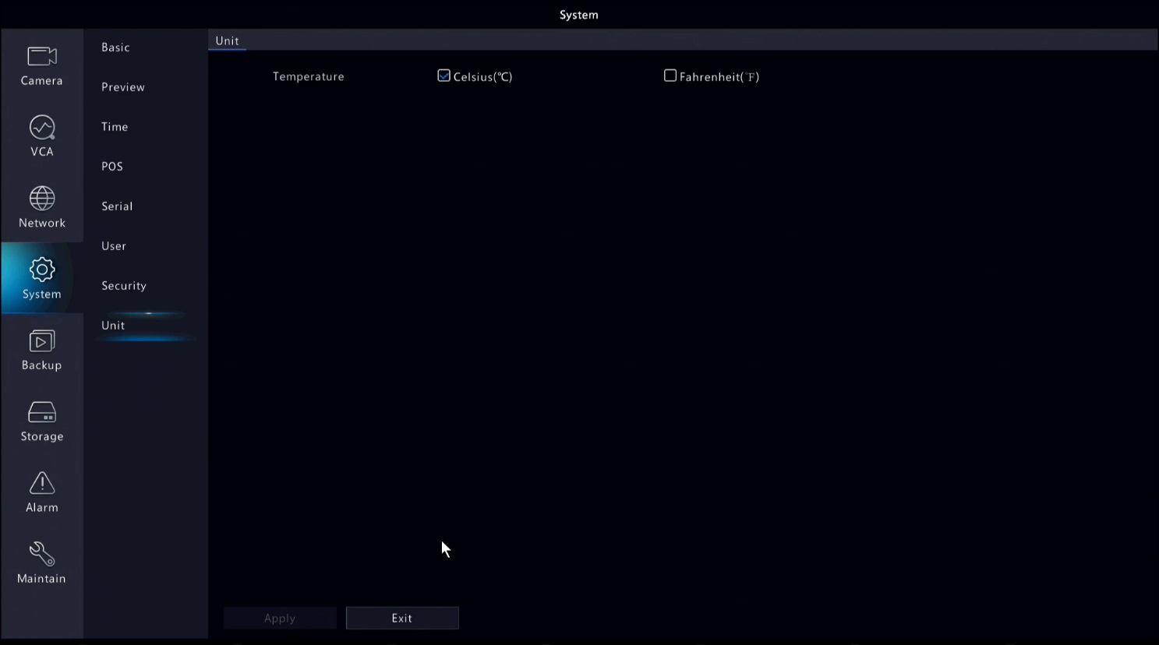
Temperature Unit Switching
℃ / ℉
The system supports Celsius and Fahrenheit temperature units
The device will not restart after switching unit, the interface will change accordingly

Slide 12

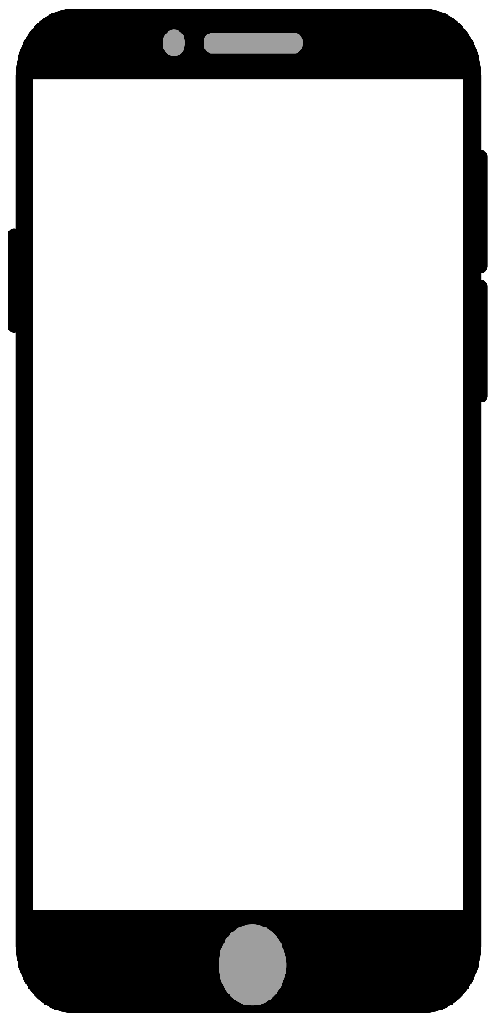
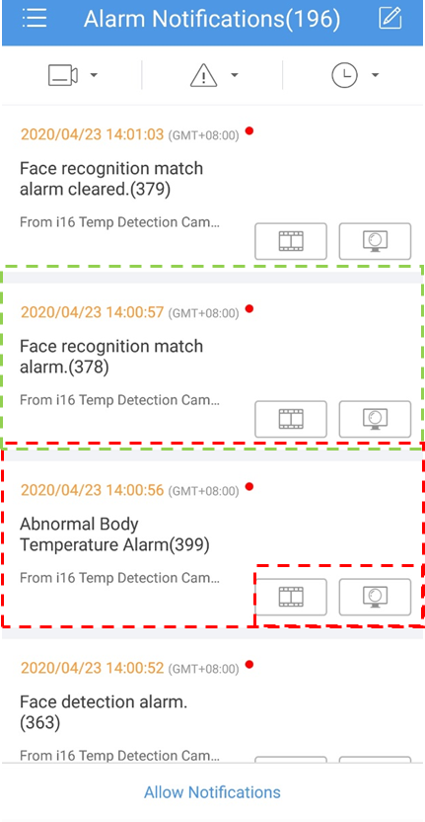

App Features
EZView
Face recognition match
Abnormal temperature alarm message reception
Playback/Liview

Slide 13
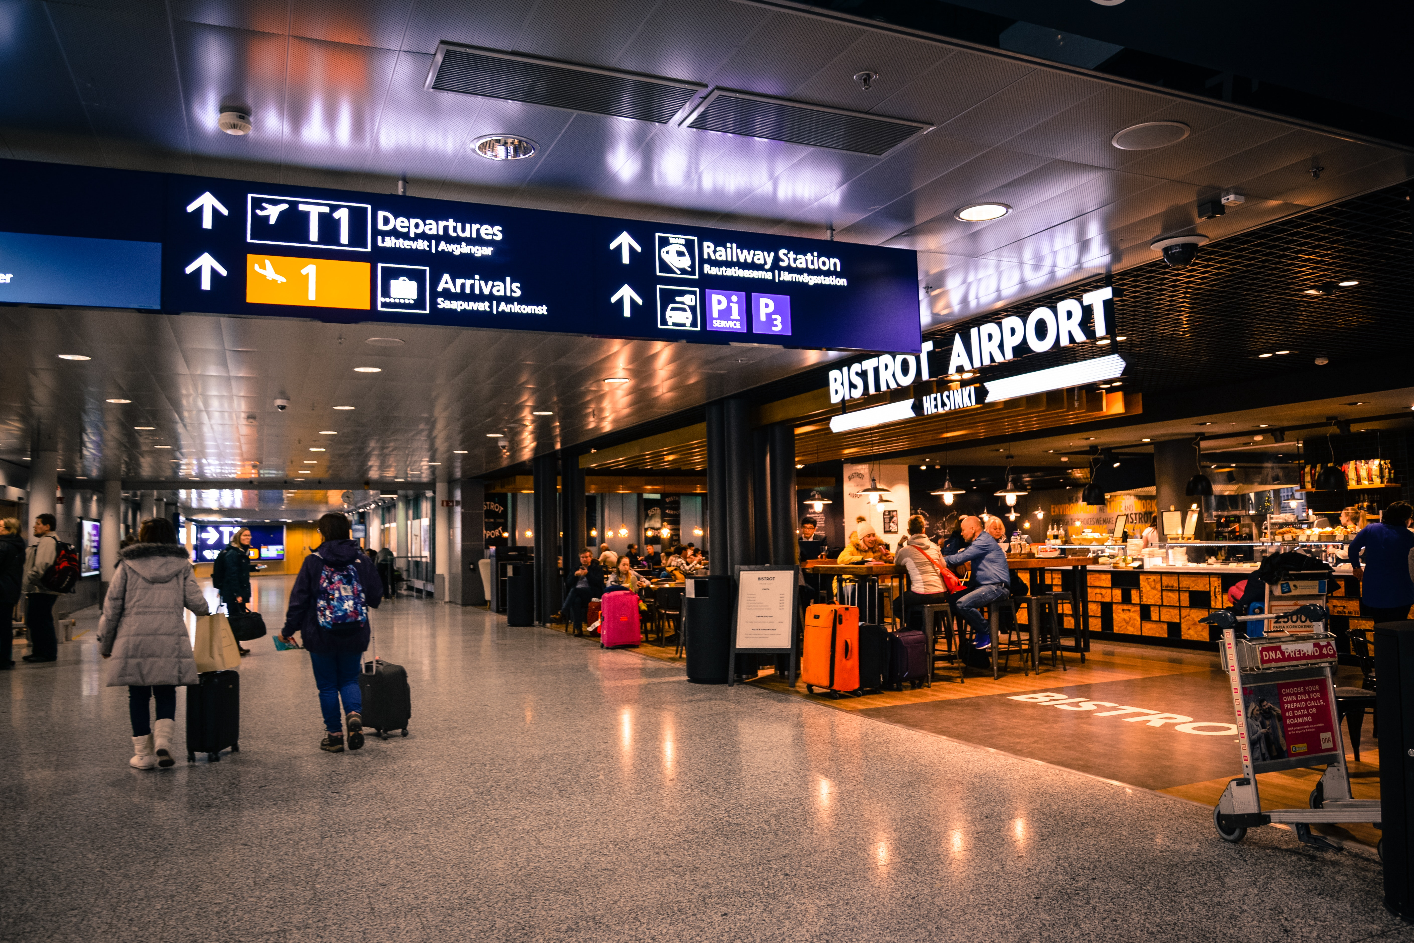
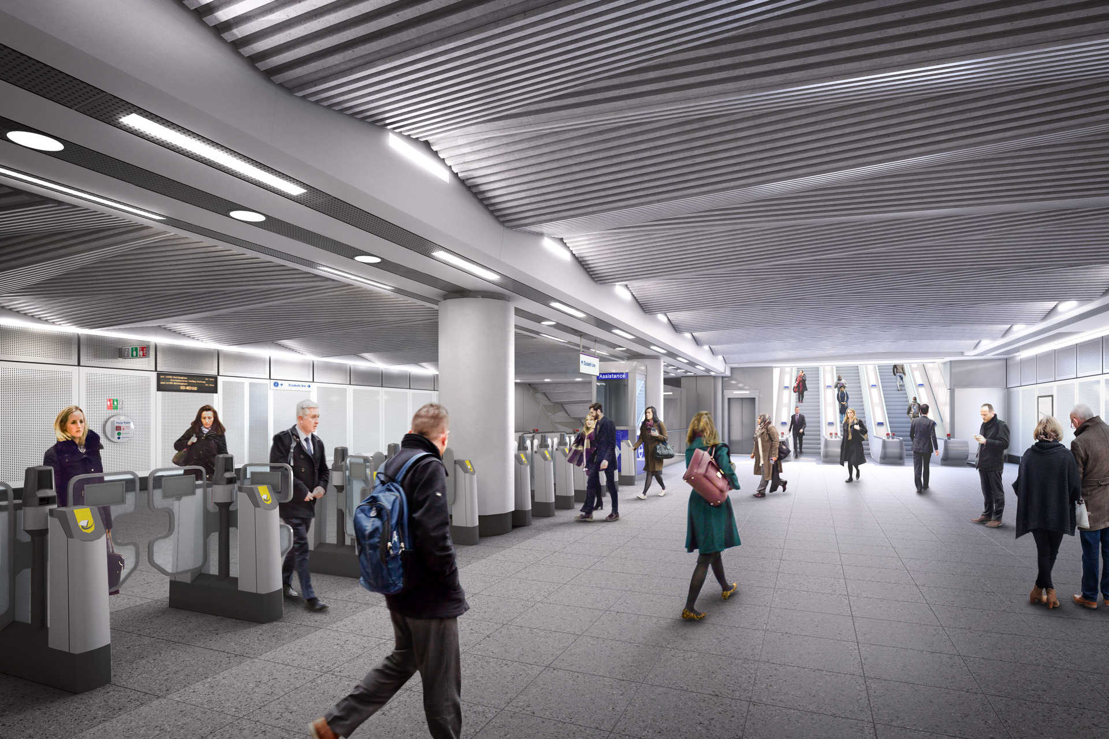
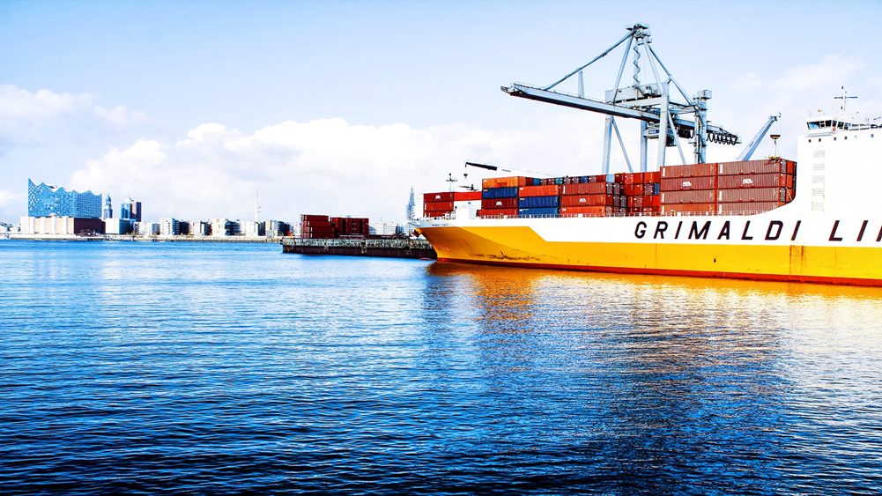
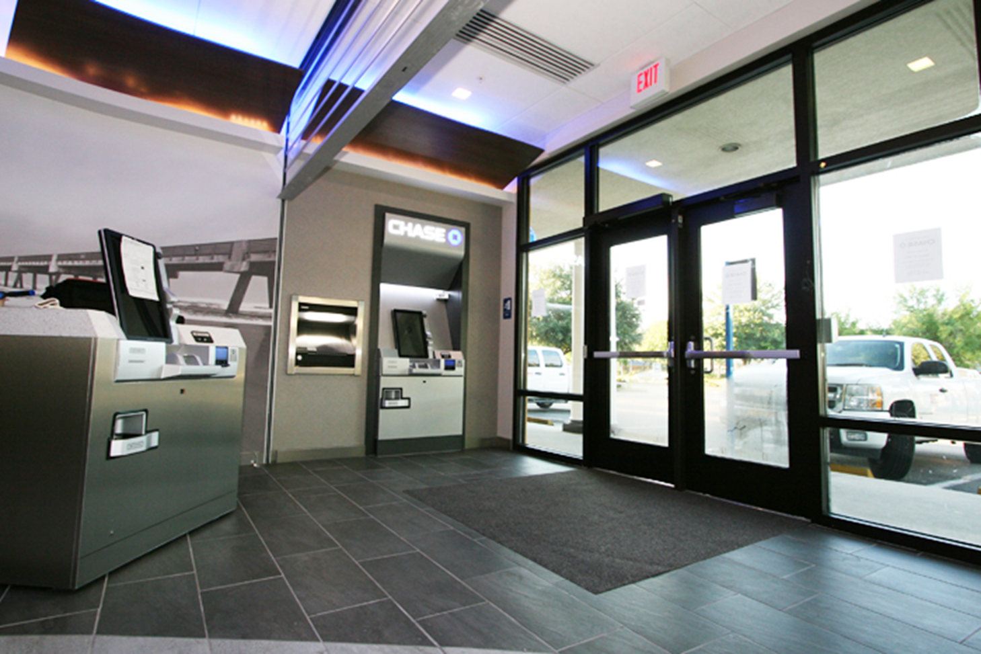
Application Scenario
Quick preliminary Screening
Long range temperature measurement
No need extra cooperation
Airport
Railway
Seaport
Bank

